Slide 1
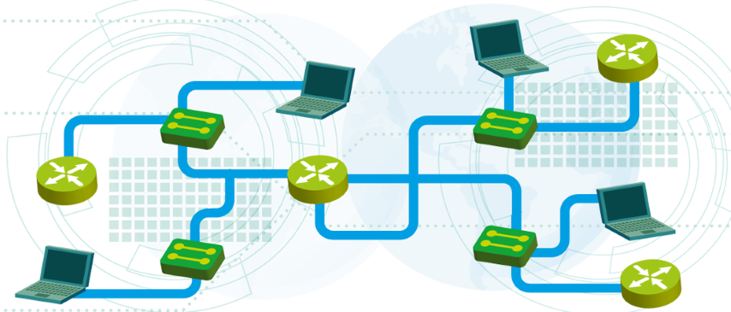

Layer 2 redundancy – Spanning Tree Protocol
Module 4
SoftUni Team
Technical Trainers
Software University
http://softuni.bg

Slide 2
Questions
sli.do #NetFund

Slide 3
Table of Contents
Spanning tree protocol (STP)
Rapid STP (RSTP)
Per-VLAN STP plus (PVST+)

Slide 4
Spanning tree protocol (STP)

Slide 5
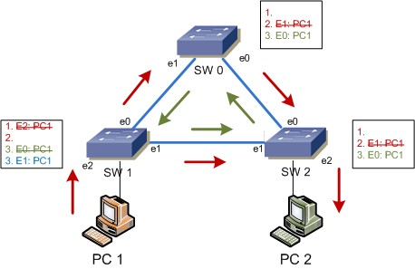
What is the Spanning Tree Protocol?
It addresses a problem which switches can not handle alone: the broadcast storms
Without STP, a L2 loop will:
Overload the links
Affect the end devices
Cause MAC table instability
…never stop

Slide 6
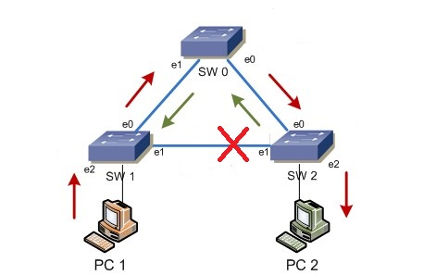
What is the Spanning Tree Protocol? (2)
All STP enabled switches “talk” to each other
The management information that they exchange is in the form of BPDUs (Bridge Protocol Data Units)
The goal is to logically block one or more ports to prevent from loops

Slide 7
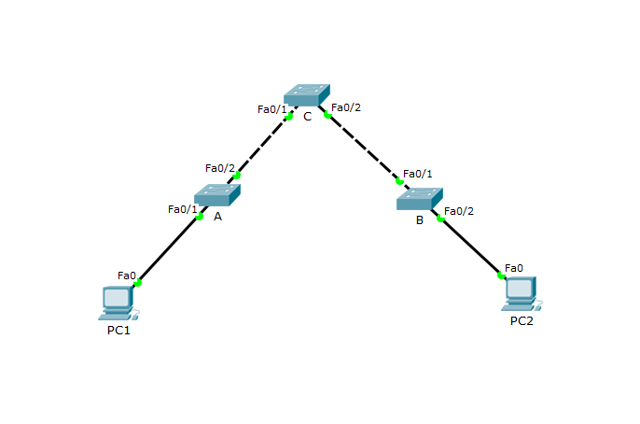
Why STP is needed?
In this topology STP is NOT needed
…but there is no redundancy

Slide 8
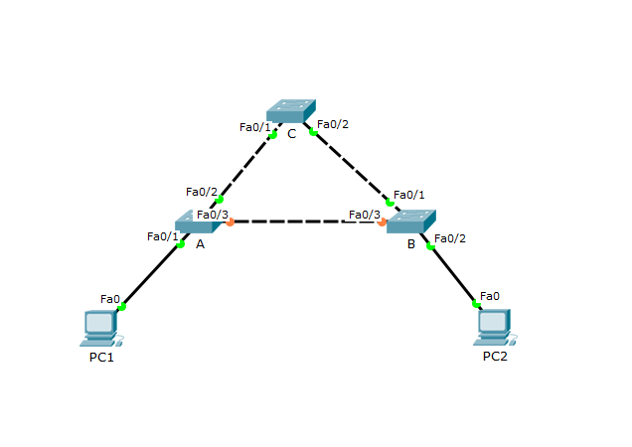

Why STP is needed? (2)
Now there is a redundancy
…but there is also the loop problem!

Slide 9
The STP algorithm
Elect the Root switch (Root bridge)
This is the switch with the lowest BID (Bridge ID)
BID = Switch Priority and MAC
Select the root ports
They have the best cost (lowest) to the Root
Selected per switch
Select the designated ports
They have the best cost (lowest) to the Root
Selected per segment (connection)
All other ports go to blocking state

Slide 10
STP tie-breakers
If there is a tie situation - the same path cost via different paths, use the following tie-breakers:
When selecting Root port or Designated port, chose the neighboring switch which has the lowest Bridge ID
If the Bridge ID is the same, select the lowest Port ID (PID)
Port ID = Port priority and port number

Slide 11
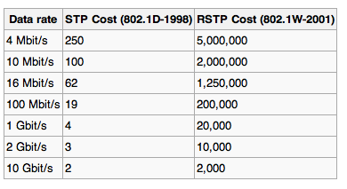
Link costs (path cost)
Higher port speed -> lower cost
The values can be changed by administrator

Slide 12
STP Priority
A number between 0 and 61440
Must be configured in increments of 4096
Default is 32768 (+ the VLAN ID)
The switch with the lowest priority will become the Root
If equal values -> lowest MAC address wins (BID = Priority and MAC)

Slide 13
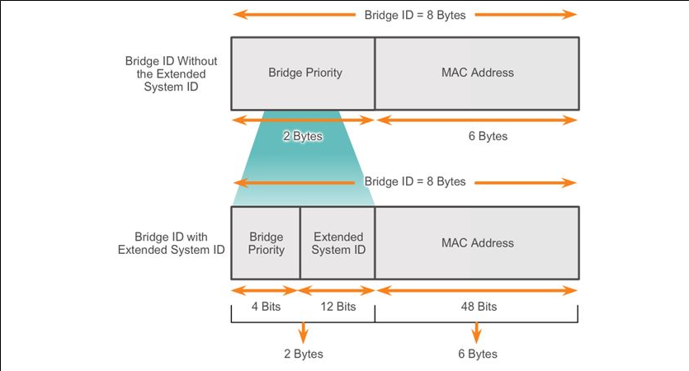
STP Priority (2)
16 bits reserved for bridge priority initially
Only the first 4 are now used for priority and the other 12 are for VLAN

Slide 14
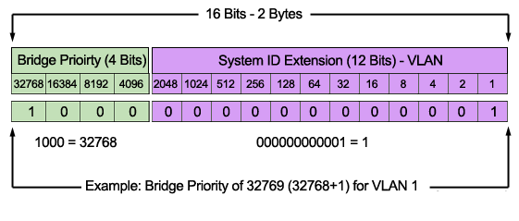
STP Priority (3)
Extended system ID is the reason for the 4096 increments

Slide 15
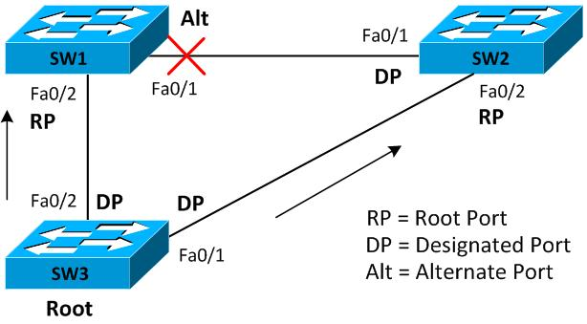
STP Example 1

Slide 16
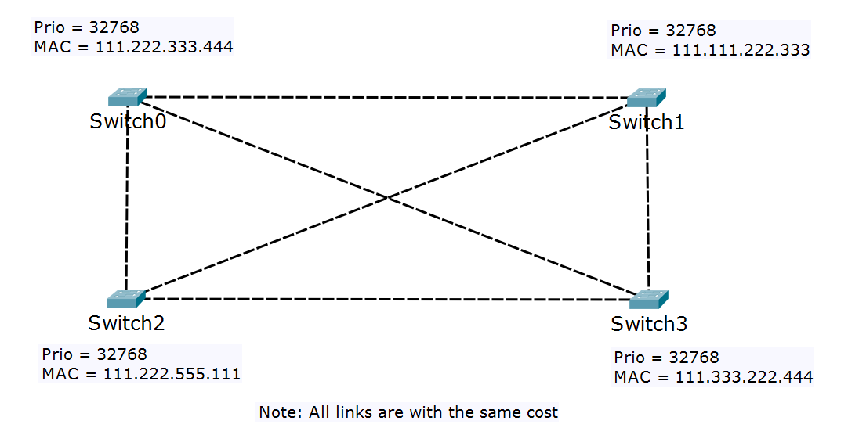
STP Example 2
Find the Root, the RP, the DP and the Blocking ports
Rp
Fa0/1
Dp
Fa0/1
Root
Fa0/2
Dp
Dp
Fa0/2
Dp
Fa0/3
Fa0/3
Dp
Fa0/2
Fa0/2
Fa0/1
Fa0/1
Rp
Rp
Fa0/3
Dp
Fa0/3

Slide 17
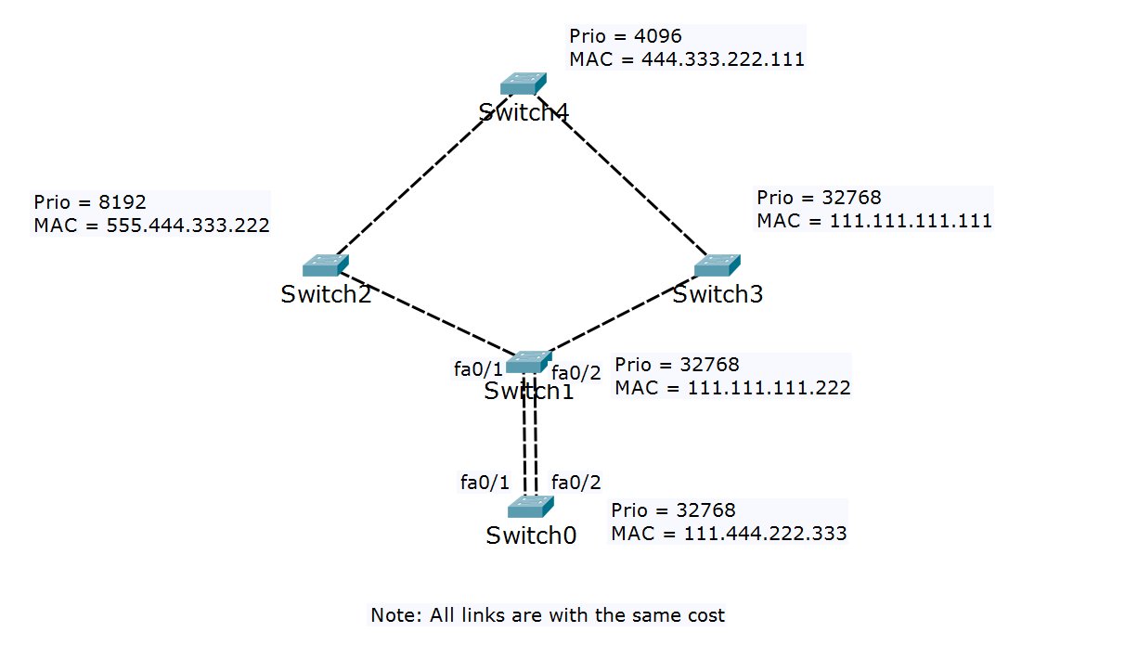
STP Example 3
Find the Root, the RP, the DP and the Blocking ports
Root
Dp
Dp
fa0/1
fa0/2
fa0/1
fa0/1
Rp
Rp
Dp
Dp
fa0/2
Rp
fa0/2
Dp
Dp
Rp

Slide 18
Questions
sli.do #NetFund

Slide 19
Rapid STP (RSTP)

Slide 20
Spanning Tree Protocol – Main Flavors
STP - Spanning Tree Protocol, IEEE 802.1D
RSTP - Rapid STP, IEEE 802.1W
MSTP - Multiple STP, IEEE 802.1S (802.1Q-2005)
PVST+ - Per-VLAN STP, Cisco proprietary

Slide 21
STP (the good old Spanning Tree)
Spanning Tree Protocol
The industry standard name is IEEE 802.1D
Slow convergence
Port states:
Disabled
Blocking (up to 20 sec)
Listening (up to 15 sec)
Learning (up to 15 sec)
Forwarding

Slide 22
RSTP (the faster STP)
Rapid STP
The industry standard name is IEEE 802.1W
Much faster convergence than STP
Introducing Edge port – a port which is connected to end device
RSTP uses the same algorithm as STP
Port states:
Discarding
Learning
Forwarding

Slide 23
Questions
sli.do #NetFund

Slide 24
Per-VLAN STP plus (PVST+)

Slide 25
PVST+
Per-VLAN Spanning Tree is Cisco protocol
Why? It has a similar idea as MSTP -
Creates a spanning tree topology separately
PortFast in PVST+ is similar to Edge port in STP/RSTP
to distribute the load
for each VLAN

Slide 26
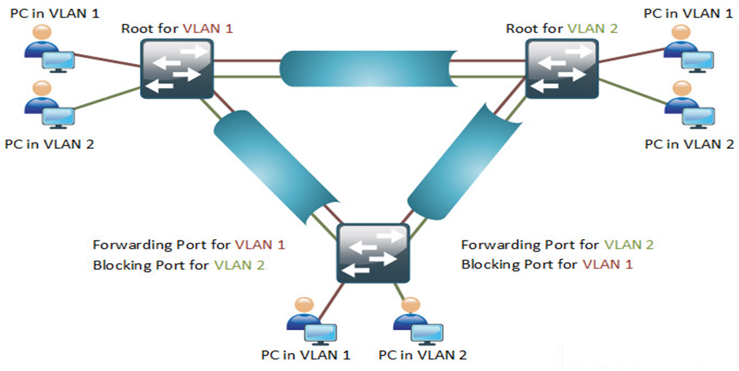
PVST+ (2)

Slide 27


PVST+ (3)
Priority: 0
Priority: 4096
Priority: 4096
Priority: 0
Vlan 1
Vlan 2
Vlan 1
Vlan 2
Switch 1
port 1
Switch 2
port 1
R
R
port 2
port 2
port 1
port 2
Switch 3
Priority: 32768
Priority: 32768
Vlan 1
Vlan 2

Slide 28
The good and the bad about PVST+
PVST+ advantages:
triggers STP calculation only if there is a potential loop in a particular VLAN
detailed “look” of the network – does not block ports when there is no loop on the trunks for a given VLAN
PVST+ disadvantages
generates a lot of overhead in the network
proprietary protocol

Slide 29
Questions
sli.do #NetFund

Slide 30
Demonstration

Slide 31

Summary
Spanning tree protocol (STP)
Rapid STP (RSTP)
Per-VLAN STP plus (PVST+)
…
…
…

Slide 33






СофтУни диамантени партньори

Slide 34






СофтУни диамантени партньори

Slide 35





Trainings @ Software University (SoftUni)
Software University – High-Quality Education, Profession and Job for Software Developers
softuni.bg
Software University Foundation
http://softuni.foundation/
Software University @ Facebook
facebook.com/SoftwareUniversity
Software University Forums
forum.softuni.bg

